Slide 1

Air quality forecasting using statistical and machine learning methods
K. E. Society’s Rajarambapu Institute of Technology, Rajaramnagar, Urun Islampur (Dist. Sangli) (An Autonomous Institute)
Review-I presentation
on
by
Akash Mahajan (Roll No.: 1954012)
guided by
Prof. Dr. Amol C. Adamuthe
Department of Information Technology
(A.Y. 2021-22)

Slide 2
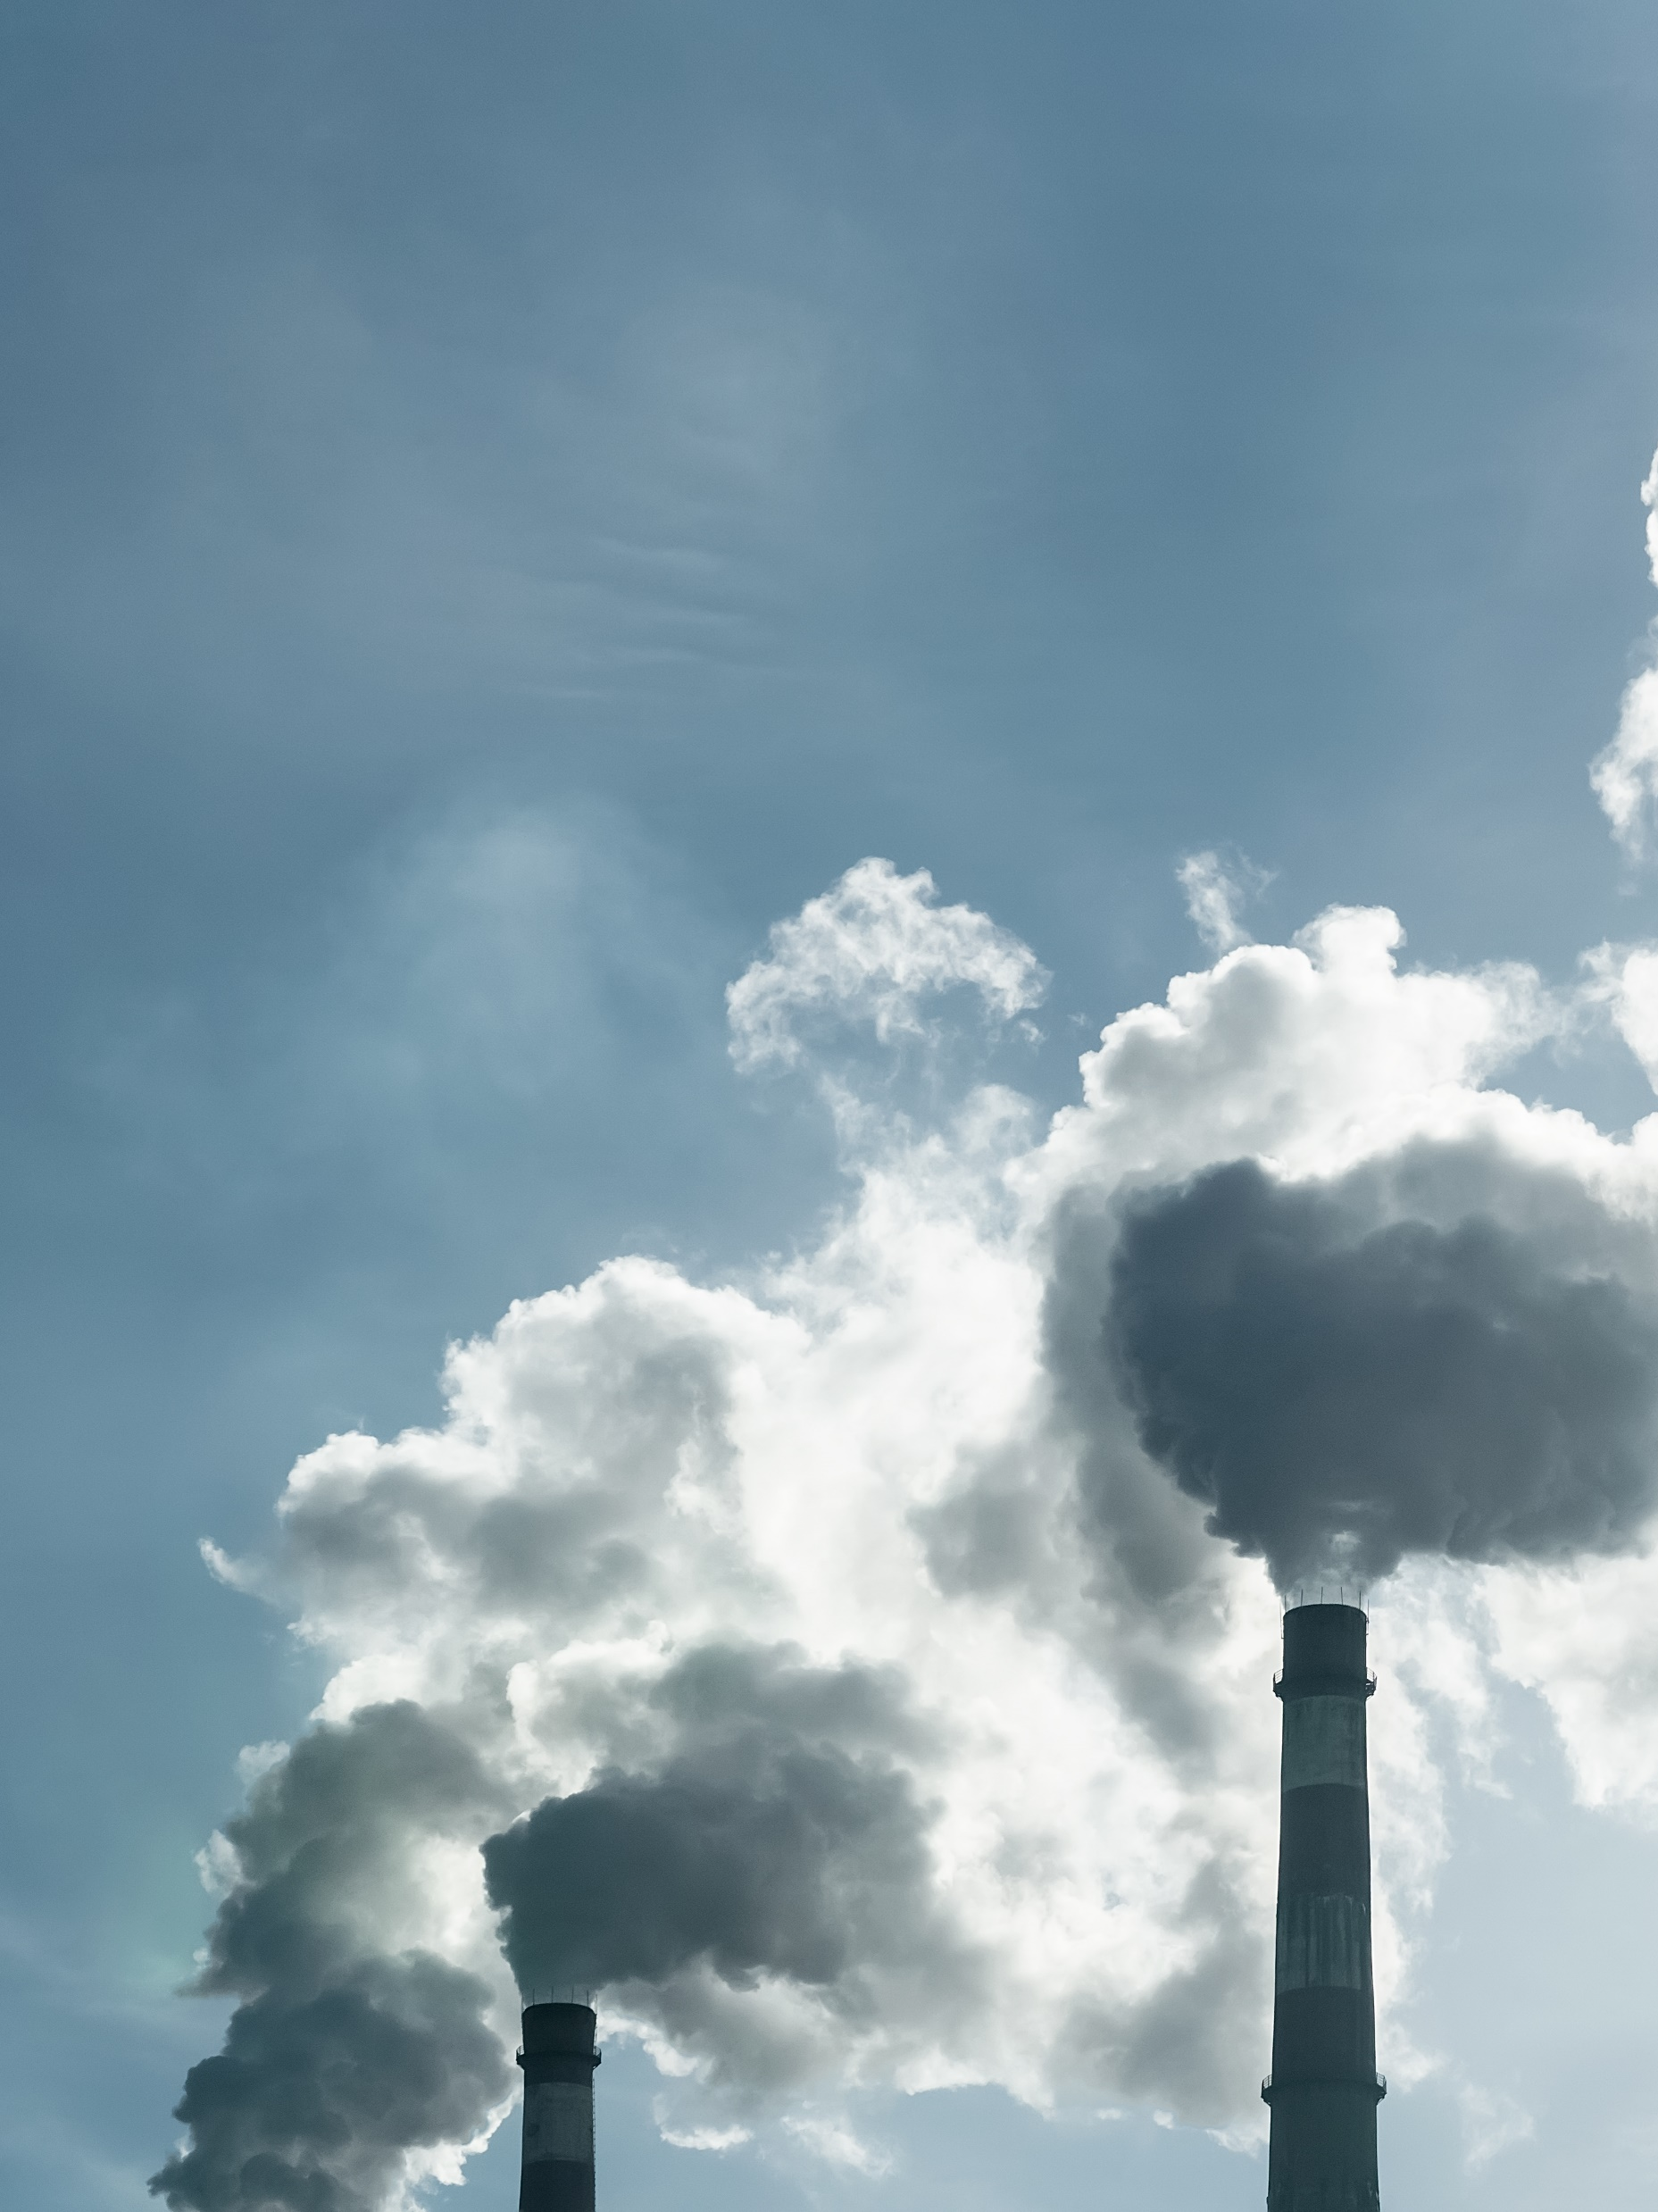
Work done so far…
Revision
List of methods & plan
Experiments
Experiment 1: Missing values imputation
Experiment 2: Moving Average
Experiment 3: Exponential Smoothing
Experiment 4: Double Exponential Smoothing
Findings & Further work

Slide 3


Revision
Literature review of statistical methods and Machine Learning methods for solving the problem of forecasting the sensor measurements.
Implementation of the statistical methods like exponential smoothing.
Implementation of learning-based algorithms such as neural network and deep learning algorithms.
Comparison of collected results and choosing the best performing model.

Slide 4

List of experiments & plan
Moving Average (MA)
Weighted Moving Average (WMA)
Exponential Smoothing (double/triple)
Autoregressive Moving Average (ARMA)
Autoregressive Integrated Moving Average (ARIMA)
Linear Prediction
Autoregressive Integrated Moving Average with Exogeneous Inputs (ARIMAX)
Almost 20% work is completed. The completed work needs a revision because of longer study gap.
Completed methods marked in bold red

Slide 5
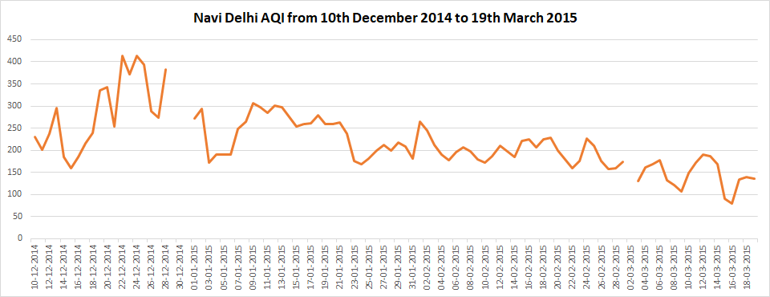
Experiment 1: Missing Values Imputation
Total observations | 2476
Missing observations out of total | 142
% of missing observations out of total | 5.7
There were several missing values found during investigation. The table above shows the basic stats about the dataset.
Missing values are imputed with results of Exponential Smoothing method using Excel software.
Missing values

Slide 6
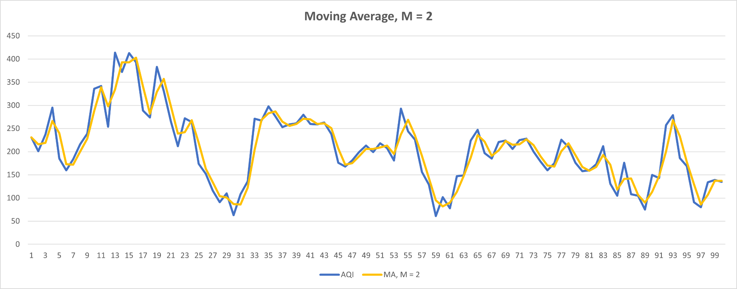
Experiment 2: Moving Average
The best fit M = 2
An estimator is nothing but a value around which the trend is predicted.
A mean as estimator has highest MSE where M = 2 has lowest MSE.
Method | Mean estimator | MA, M = 2 | MA, M = 3 | MA, M = 5
Mean Squared Error | 5896 | 631 | 1274 | 2349

Slide 7
Experiment 3: Exponential Smoothing
Following table is the comparisons of various moving average estimator configurations. The value for ɑ = 0.8 gives the minimum Mean Squared Error (MSE) value. Still, the MSE achieved in the MA method is far better.
Ɑ value | 0.2 | 0.3 | 0.5 | 0.8 | 0.9 | 1
MSE | 3955 | 3411 | 2834 | 2522 | 2519 | 2558

Slide 8
Experiment 4: Double Exponential Smoothing
Following table is the experimentation for finding Mean Squared Error using all possible values of ɑ and Ƴ. The value pair for (ɑ, Ƴ) = (1, 0.1)
Ɑ \ Ƴ | 0.0 | 0.1 | 0.2 | 0.3 | 0.4 | 0.5 | 0.6 | 0.7 | 0.8 | 0.9 | 1
0.0 | 3131318 | * | * | * | * | * | * | * | * | * | *
0.1 | 86205 | 9433 | 7160 | 7340 | 8036 | 9306 | 8238 | 8862 | 8753 | 10265 | 10581
0.2 | 24739 | 4103 | 3788 | 3965 | 4098 | 4569 | 4420 | 4430 | 4455 | 4553 | 4471
0.3 | 11824 | 2443 | 2338 | 2426 | 2416 | 2585 | 2534 | 2611 | 2687 | 2758 | 2766
0.4 | 6836 | 1516 | 1443 | 1492 | 1546 | 1624 | 1639 | 1695 | 1739 | 1785 | 1838
0.5 | 4461 | 962 | 913 | 947 | 981 | 1079 | 1096 | 1172 | 1239 | 1318 | 1382
0.6 | 2995 | 604 | 569 | 609 | 665 | 769 | 813 | 887 | 969 | 1084 | 1172
0.7 | 2125 | 370 | 358 | 412 | 478 | 586 | 667 | 773 | 886 | 1017 | 1157
0.8 | 1542 | 216 | 233 | 310 | 402 | 530 | 644 | 790 | 949 | 1137 | 1327
0.9 | 1170 | 145 | 192 | 293 | 421 | 585 | 747 | 951 | 1171 | 1435 | 1732
1 | 927 | 132 | 217 | 358 | 535 | 755 | 994 | 1294 | 1640 | 2062 | 2573
Ɑ \ Ƴ | 0.090 | 0.091 | 0.092 | 0.093 | 0.094 | 0.095 | 0.096 | 0.097 | 0.098 | 0.099 | 0.1
0.95 | 129 | 131 | * | 132 | 133 | 132 | 128 | * | 130 | 131 | 134
0.96 | 130 | * | 128 | 130 | * | 131 | 126 | * | 129 | 130 | 136
0.97 | 130 | 131 | 125 | * | 128 | * | 129 | * | 128 | 129 | 130
0.98 | 126 | * | * | 127 | 128 | 127 | 129 | 128 | 132 | 128 | 129
0.99 | 125 | 127 | * | 128 | 131 | 132 | 129 | * | 128 | 128 | 131
1 | 128 | * | 131 | 132 | 131 | * | 127 | 129 | 132 | * | 2573
Table 2.Refining the values of ɑ and Ƴ further

Slide 9
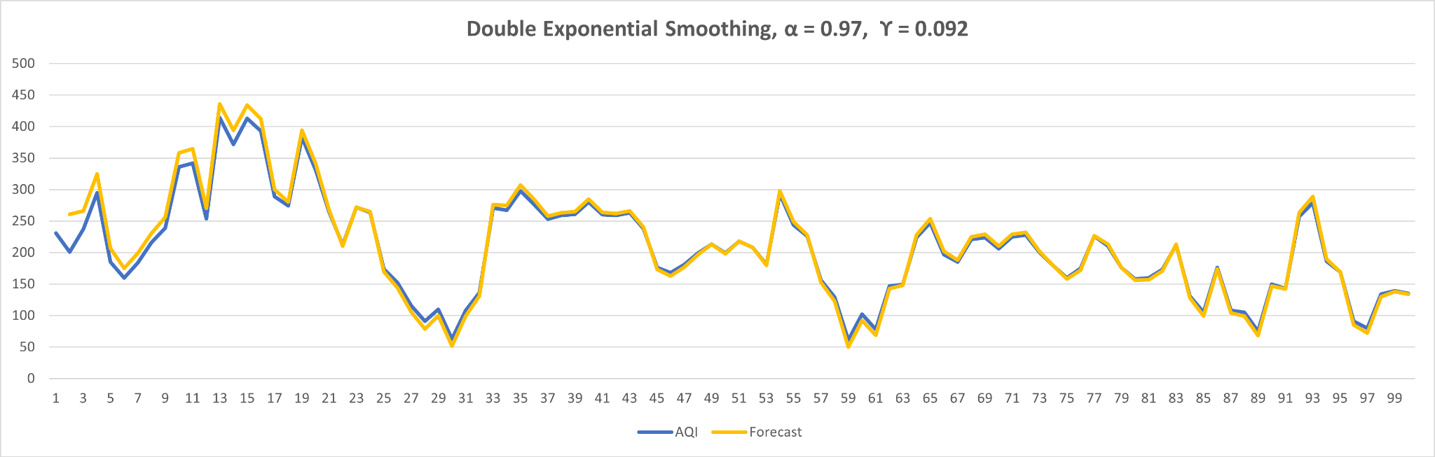
Experiment 4: Double Exponential Smoothing
An almost perfectly matched trendline. What about forecast?

Slide 10
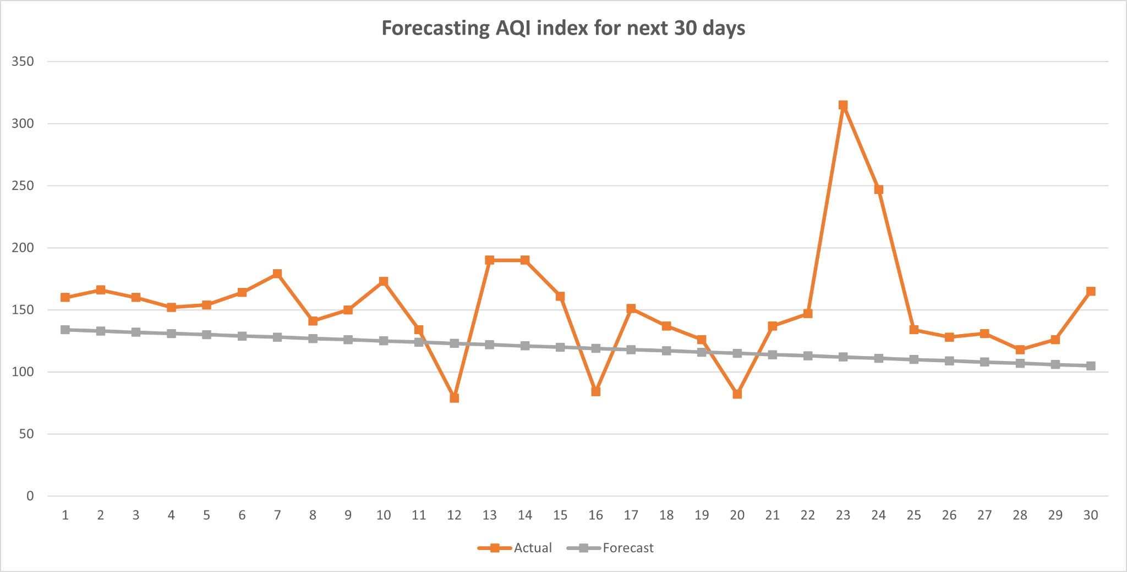
Experiment 4: Double Exponential Smoothing
Even though DES trendline matched exactly to the originally observed trendline, it didn’t perform well during forecasting. The MSE = 3148 which was 125 during training.

Slide 11
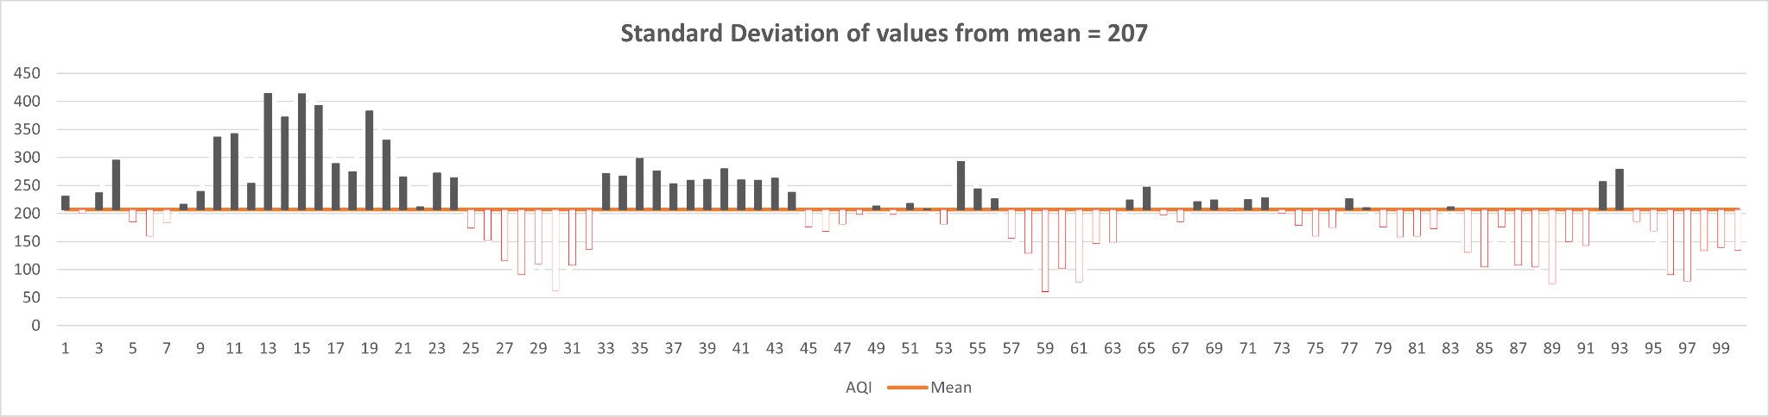
Bonus Experiment: Standard Deviation
We calculate the standard deviation of the given input data.
Standard deviation is widely used in weather forecasting to understand how much variation exists in daily and monthly temperatures in different cities. For example: A weatherman who works in a city with a small standard deviation in temperatures year-round can confidently predict what the weather will be on a given day since temperatures don’t vary much from one day to the next.
“Source: www.statolgy.org

Slide 12
Findings and future work
The given trendline is almost non-linear in its nature because of varying effect of hidden parameters on the AQI.
Compared statistical methods are alone not sufficient to get a good results i.e., accurate prediction or almost full accuracy.
The compared or yet to compare methods can be used to know the trend function or the nature of trend in terms of mathematical model.
The RNN or more sophisticated Machine Learning algorithms are necessary in order to find out non-linear relationship among the data points.
Standard deviation is useful to minimize the errors in prediction. Higher deviation value will eventually affect the prediction and trendline.

Slide 13
Thank you.

